Slide 1




milesight & GENETEC Integration
Make Sensing Matter
Superior Compatibility, Flourishing Eco-system

Slide 2

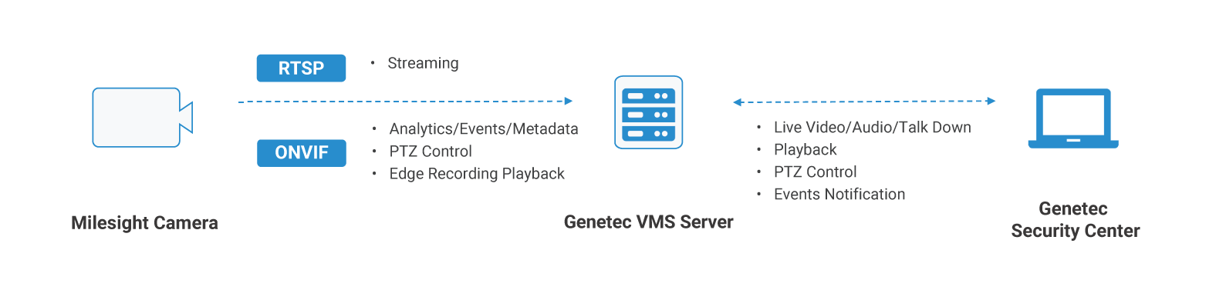


HOW MILESIGHT Deep Integrated
with GENETEC
片]
Make Sensing Matter

Slide 3


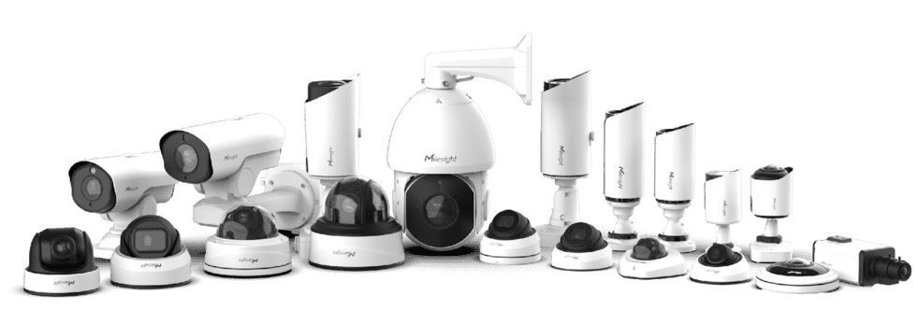
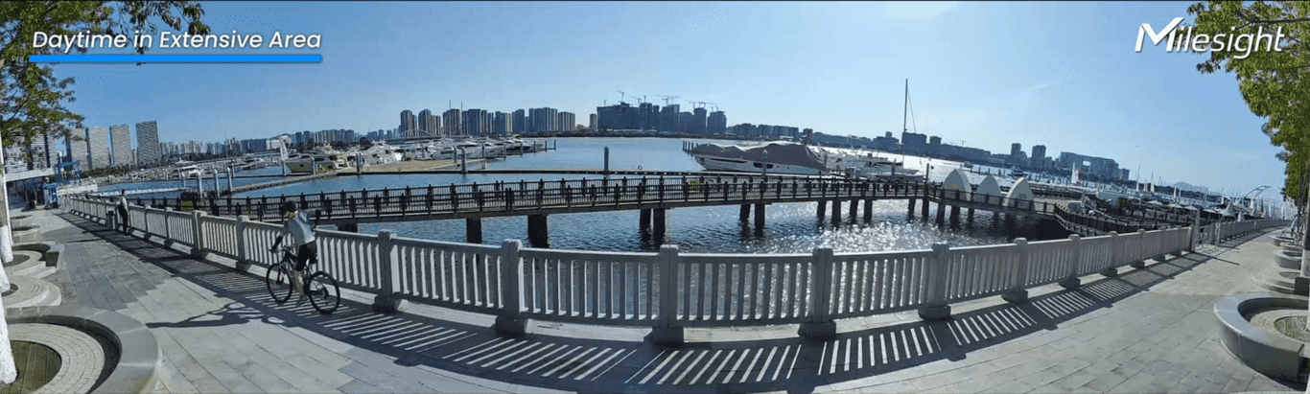
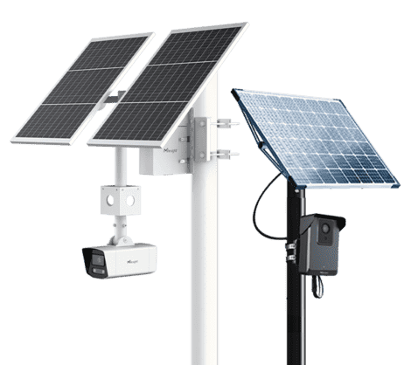

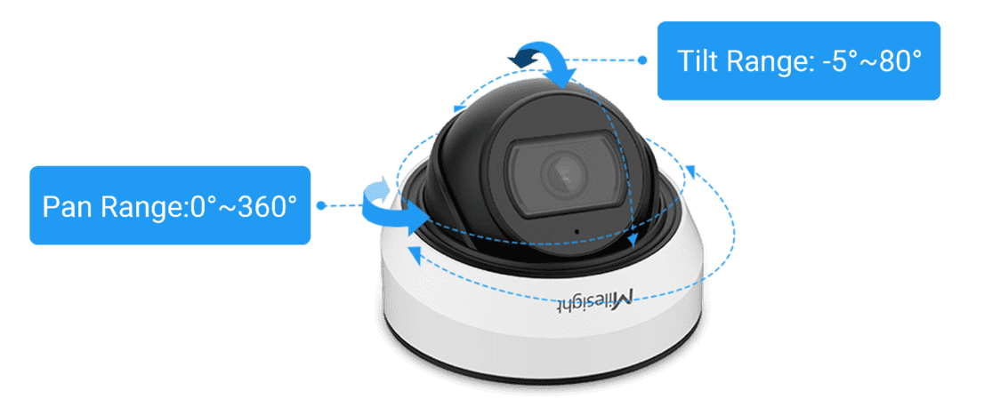
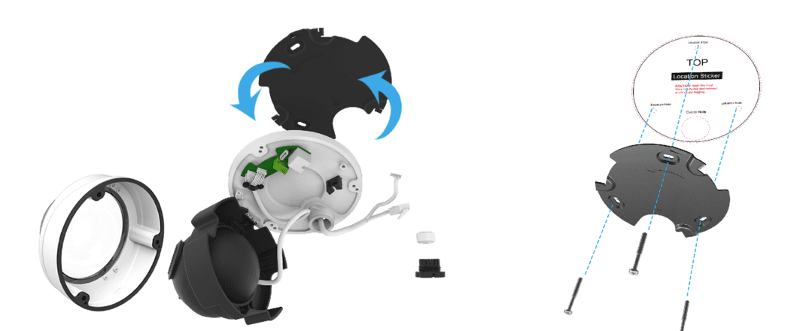

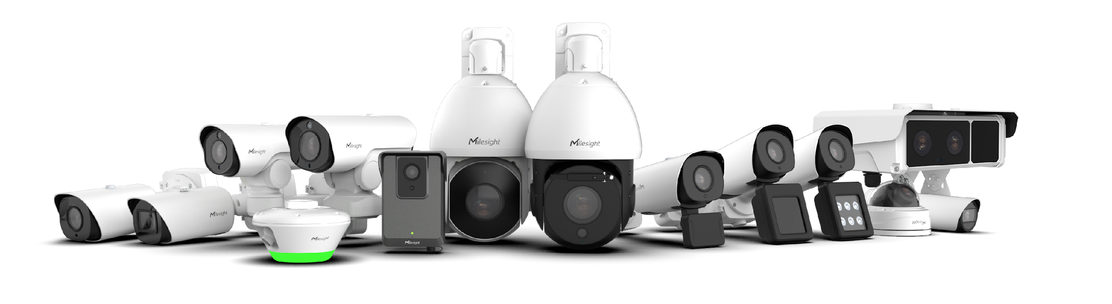

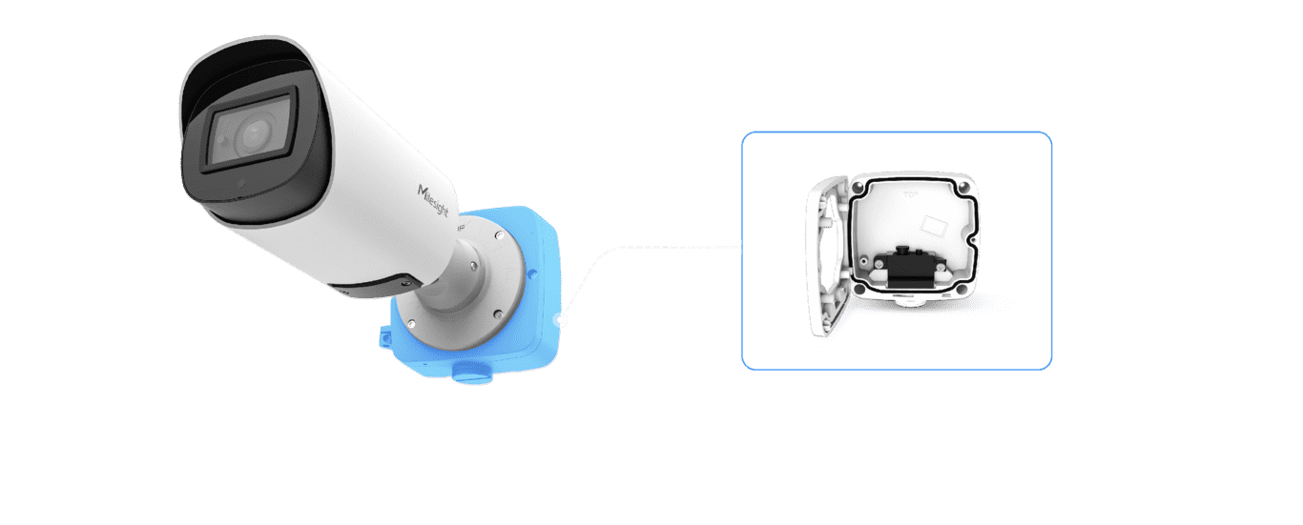
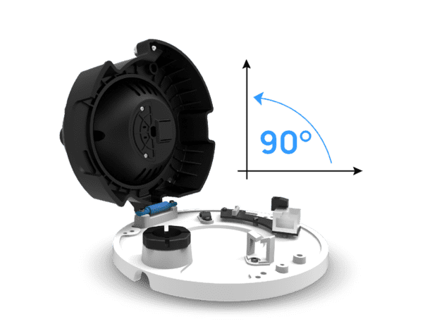
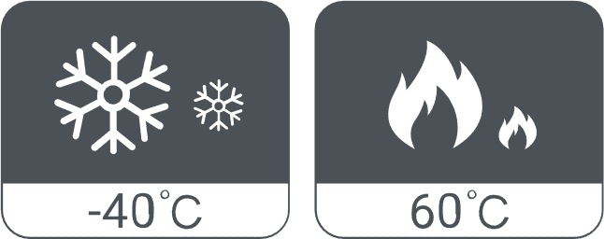

Various products compatible to meet diverse scenarios
[图片]
[图片]
SUPPORTED PRODUCT LINEUP
High Quality Image
2MP/5MP/4K/12MP
60fps/90fps/100fps
0.001Lux Ultra Low-light
140dB WDR
Milesight-AI ISP
Security Camera
[图片]
Unique Design for Easier Installation and Protection
4G Solar-Powered Series
3-Axis Design
Panel Bracket
Intelligent Traffic
Integrated Junction Box
Clamshell Design
Make Sensing Matter

Slide 4
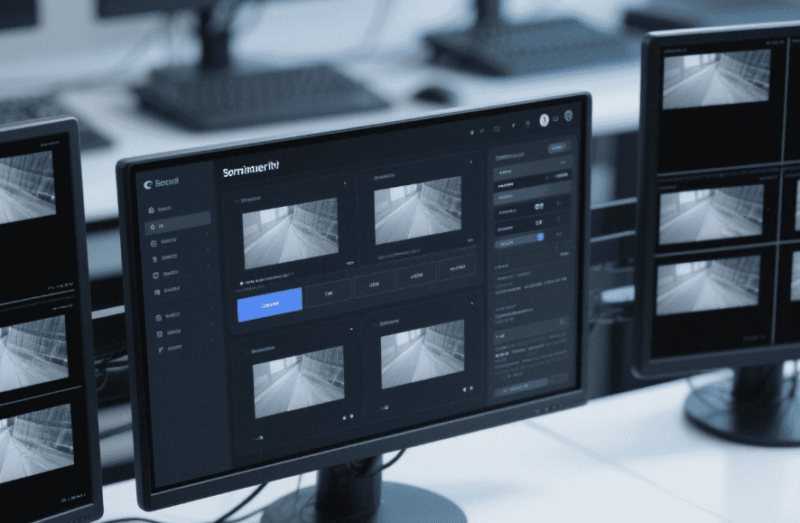
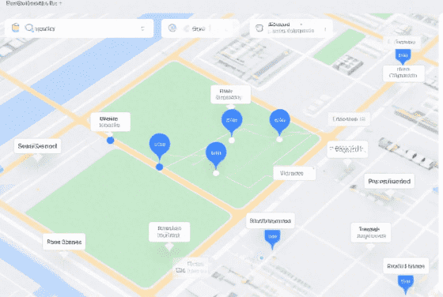

SMART FEATURES OF
THE INTEGRATION
[图片]
01
02
03
Easy Monitoring
Easy control for multiple cameras from a single interface.
Scalable and Flexible Deployment
Supporting deployment from single facilities to multi-site locations and operating seamlessly across diverse environments.
Centeralized Management of Alarms
Receiving multiple events from device in real-time.
Low false alarm rate by edge AI.
Make Sensing Matter

Slide 5
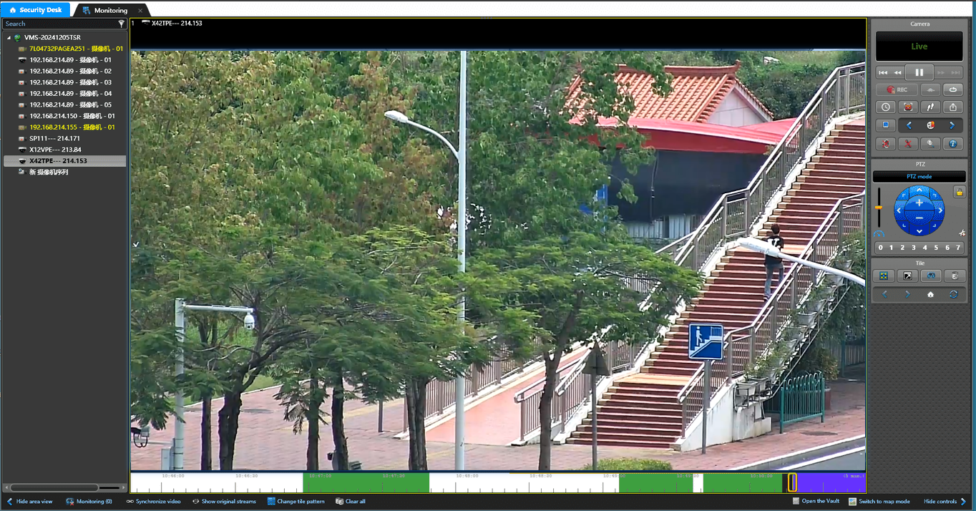
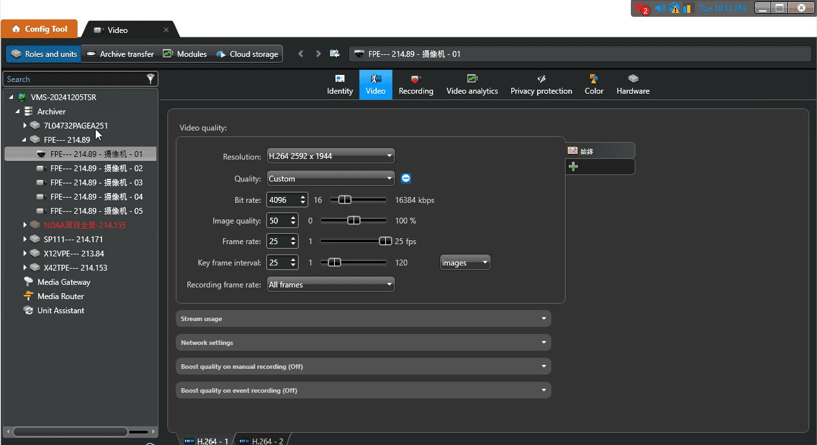
EASY MONITORING
You can start monitoring multiple cameras in Genetec easily.
Liveview & Playback
Media Configuration
[图片]
[图片]
High definition image
Two-way Audio
Multiple Layout
Quick Configuration
Integrated Setting Interfaces

Slide 6
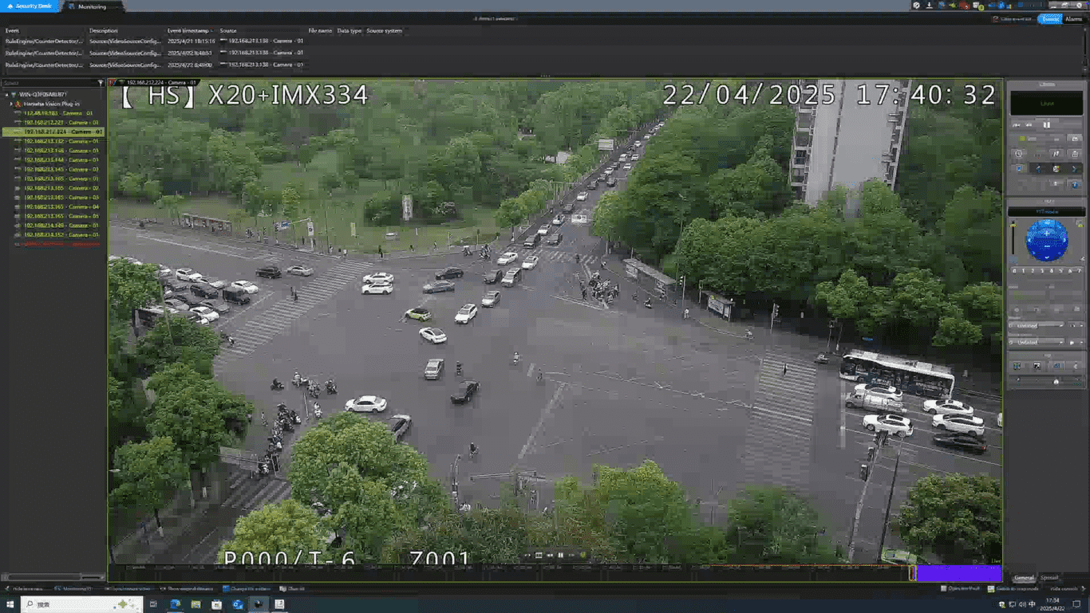
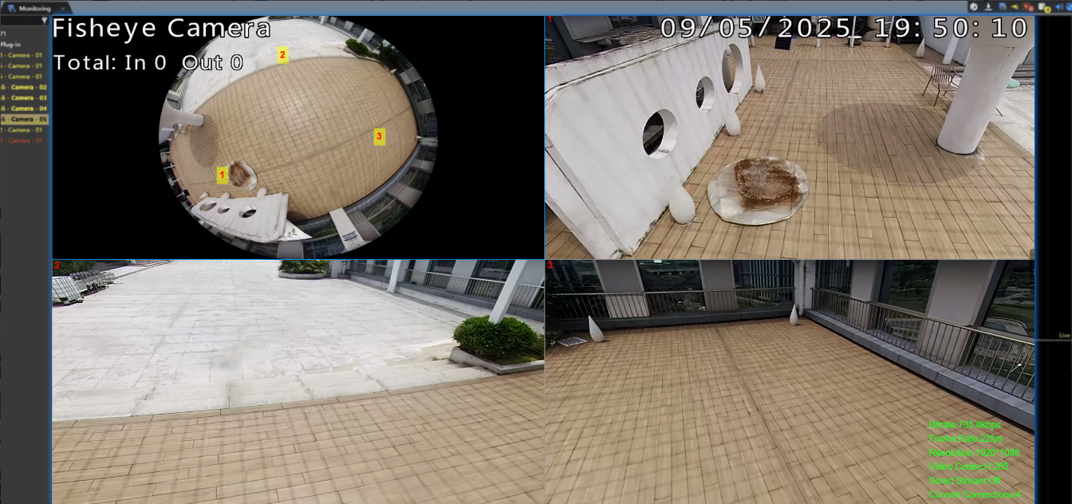
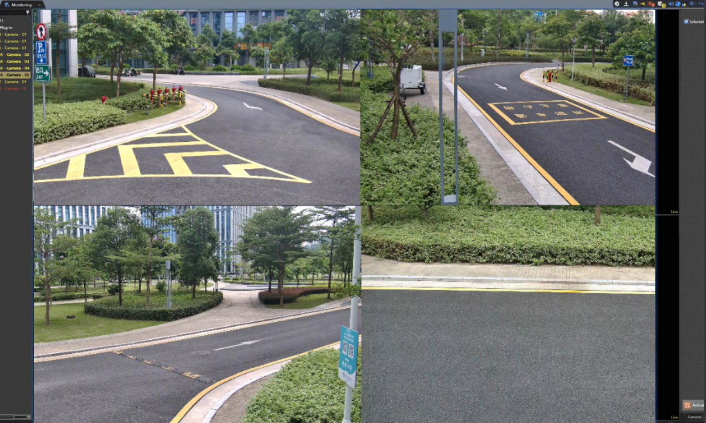
EASY MONITORING
Ensures seamless compatibility across various models.
[图片]
[图片]
[图片]
Standard PTZ
Fisheye
Multi-sensor Camera
Live View
(Click to Play the Video)
Pan/Tilt/Zoom with Instant Respinse
Save and Call the Preset
Event-triggered Patrol
Supports multiple display modes.
Easily access with one license.
Make Sensing Matter

Slide 7
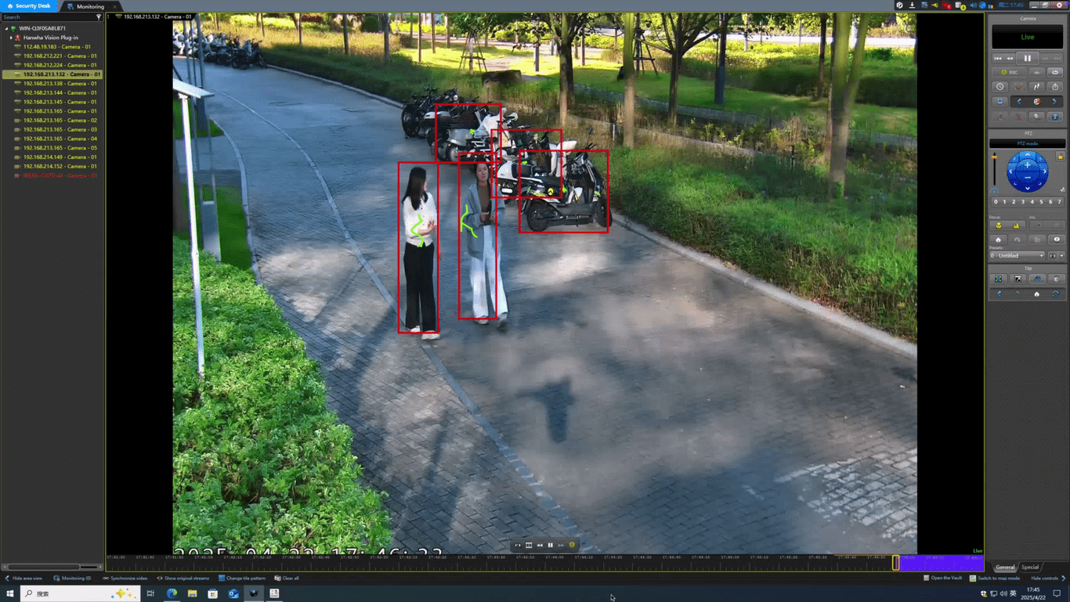





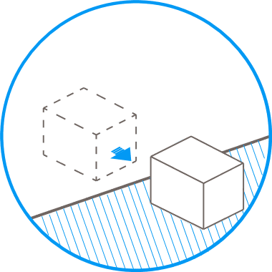

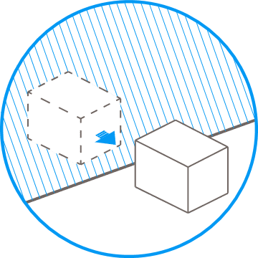




Intelligent Surveillance with Milesight VCA Function
[图片]
Milesight’s VCA functionality is deeply integrated and fully compatible with Genetec, providing users with a suite of intelligent features that elevate security management.
Region
Entrance
Region
Exiting
Object
Left
Advanced
Motion
Detection
People
Counting
Regional
People
counting
(Click to Play the Video)
· Real-Time Target Detection
On the platform, you can see tracking boxes around detected people and vehicles.
· Get camera alerts for VCA events.
Object
Removed
Tamper
Detection
Line
Crossing
Loitering
Intrusion
Detection
Vehicle
Counting
Make Sensing Matter

Slide 8


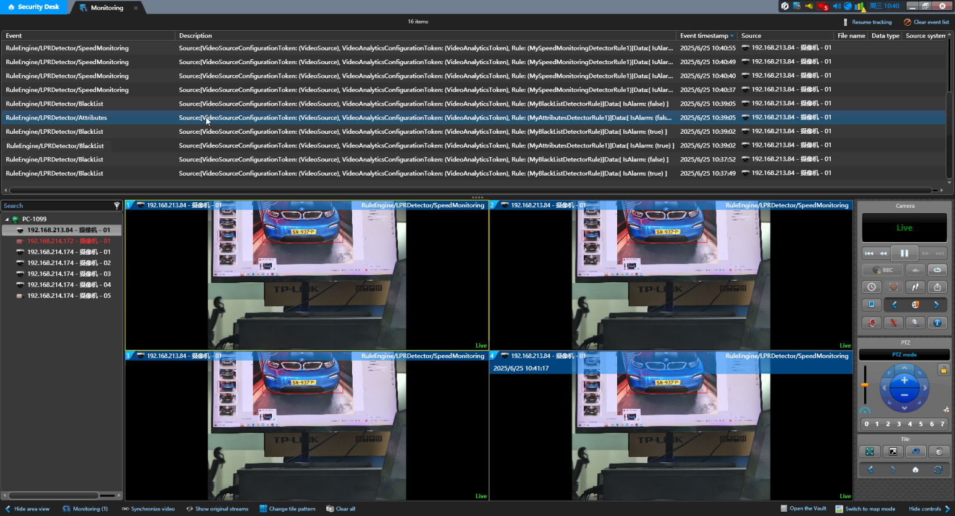








Integration with
Milesight ANPR camera
[图片]
Milesight's Intelligent Traffic Camera, deeply integrated with Genetec, detects traffic events, and offers intelligent features for effective traffic management and road safety.
Non-Plate Recognition
White List Management
Speed Detection
Black List Management
Reverse Driving
Visitor List Management
Receive specific event triggers in Genetec Security Center.
Make Sensing Matter

Slide 9

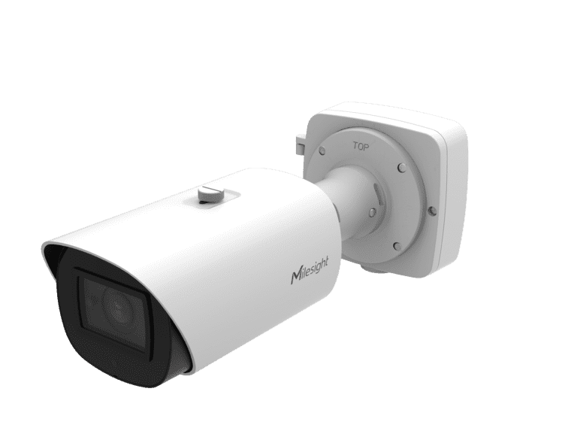

DATA SECURITY WITH EDGE
RECORDING and anr
[图片]
Ensure Recording Integrity
Play recordings from the camera's SD card to fill gaps caused by VMS server disconnections.
Automatic Recovery from SD Backup
Automatically recover missing recordings from the camera's SD card when disconnected from the Genetec server.
Recorded Data Transmission Back
SD Card
Network Breaks Down
Make Sensing Matter

Slide 10

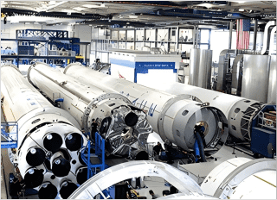
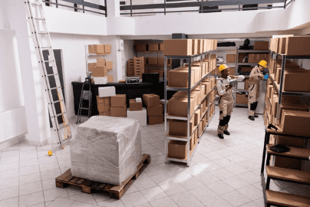
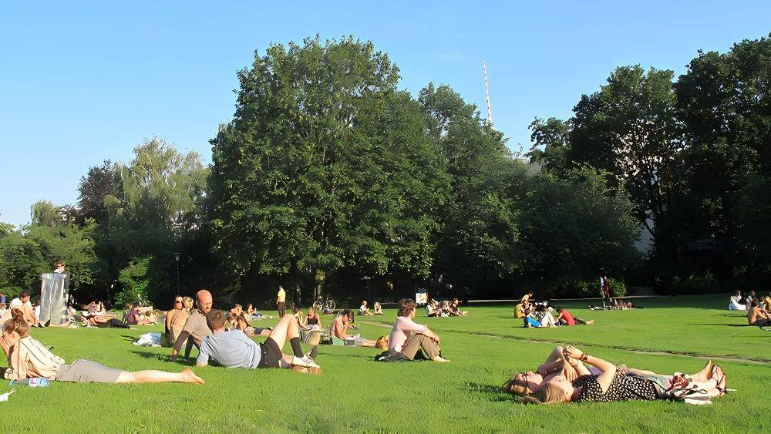
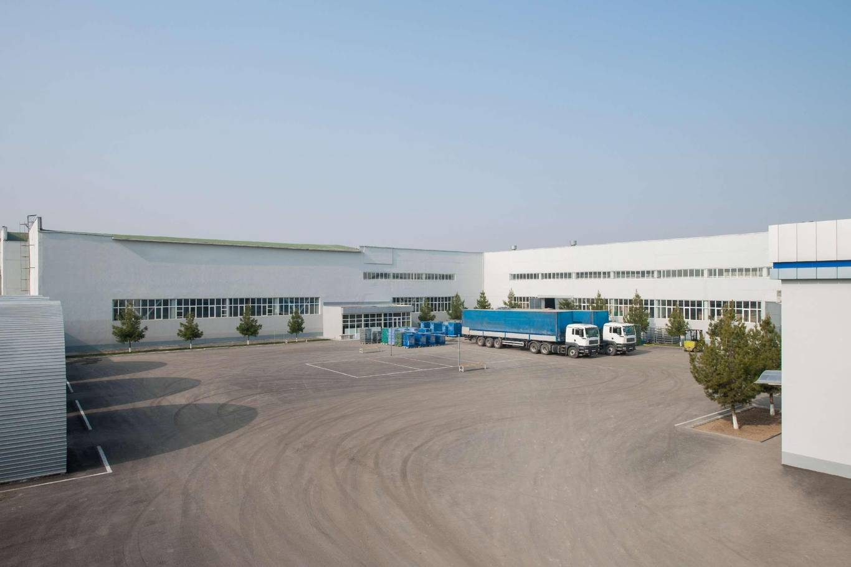
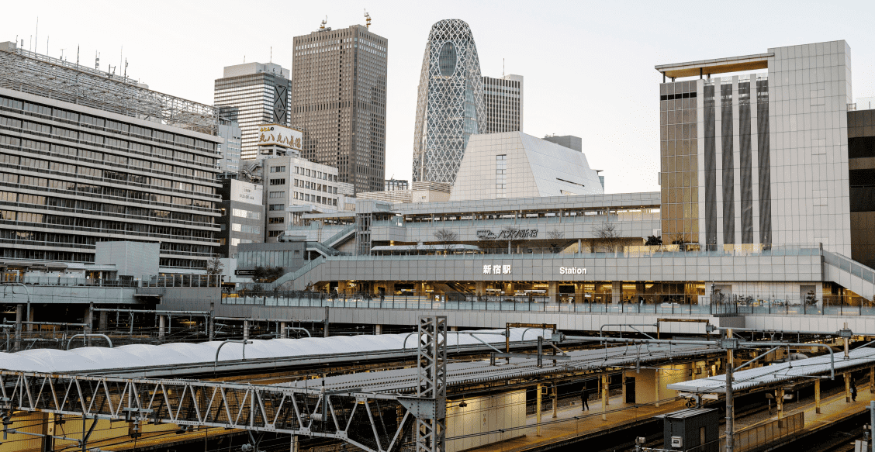
Real world application
[图片]
Supermarket
Facilities
Warehouse
Plaza
Industrial Park
Station
Make Sensing Matter

Slide 11
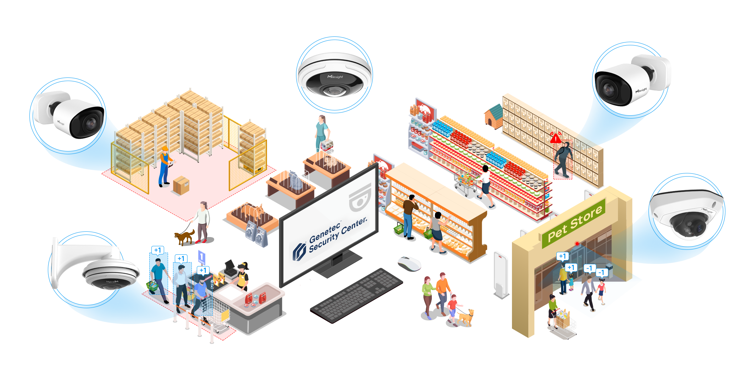
Solutions for retail
Loitering Detection
Intrusion Detection
Crowd Management & People Counting
Regional People Counting
Make Sensing Matter

Slide 12

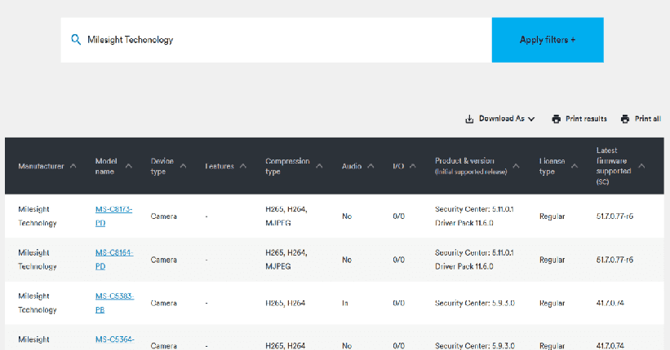
Genetec Official Certification
https://www.genetec.com/supported-device-list?category_type=camera&page=1&q=Milesight&size=10&sortBy=_score&sortType=desc
To support large-scale and regulation-sensitive deployments, our solution has successfully completed official Genetec certification. All products in the Pro Series, PTZ Series, Mini and Color⁺ Series are now listed as Genetec Supported Devices.
Make Sensing Matter

Slide 13
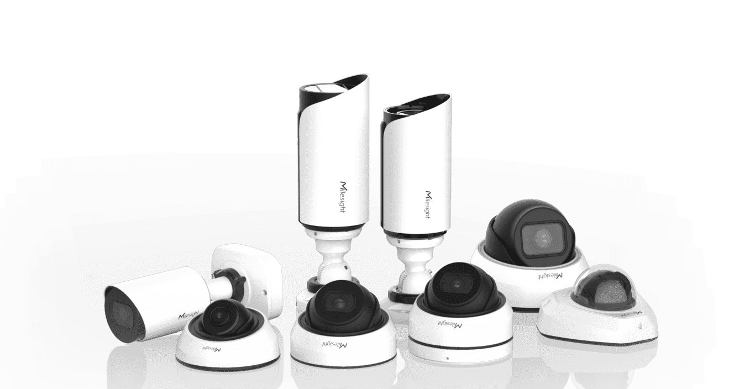

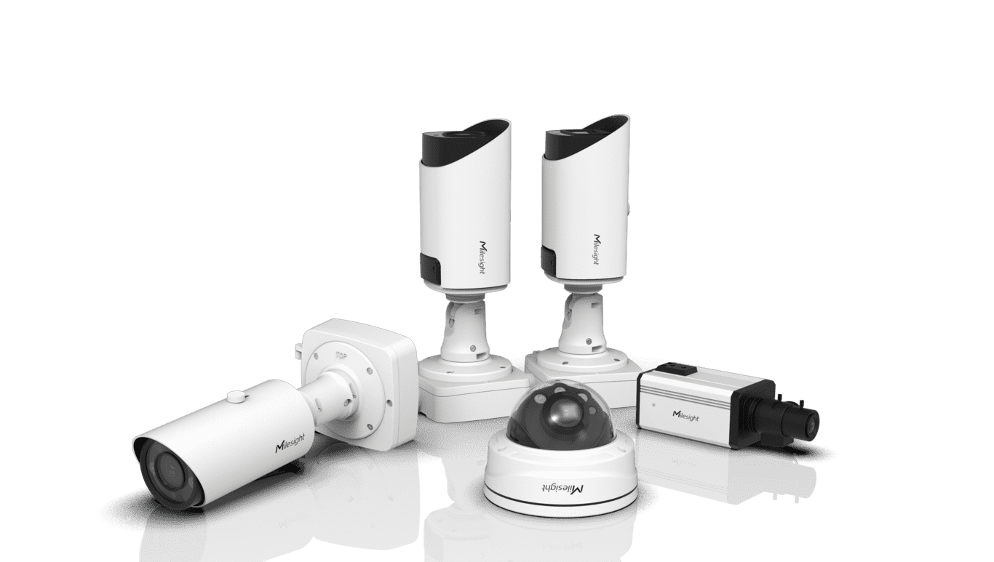
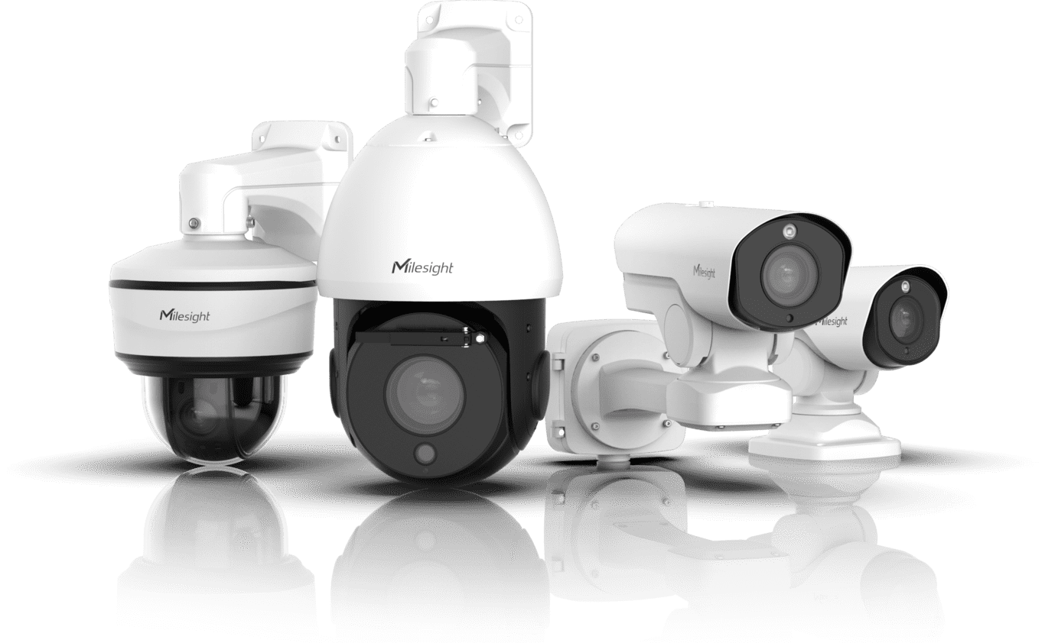
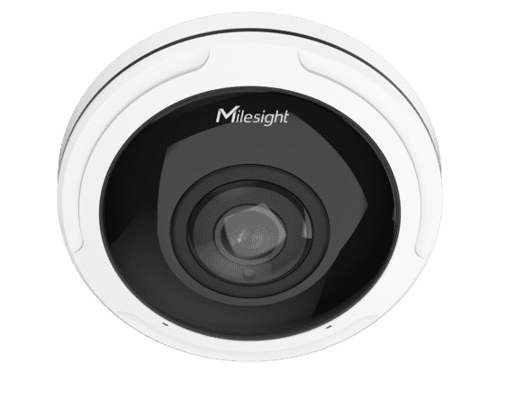
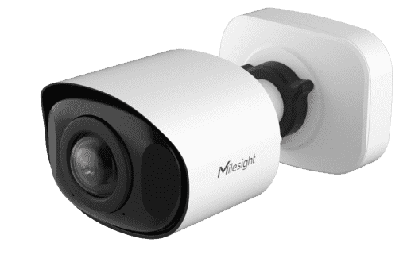
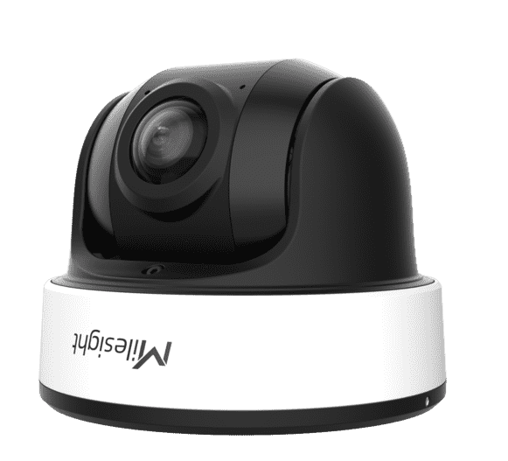
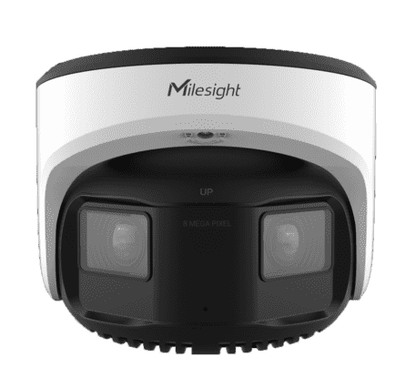
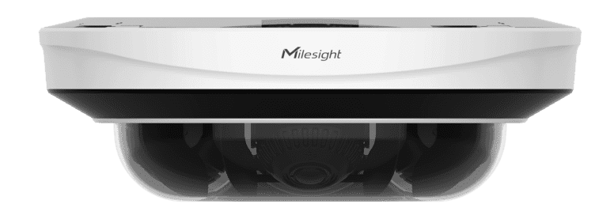
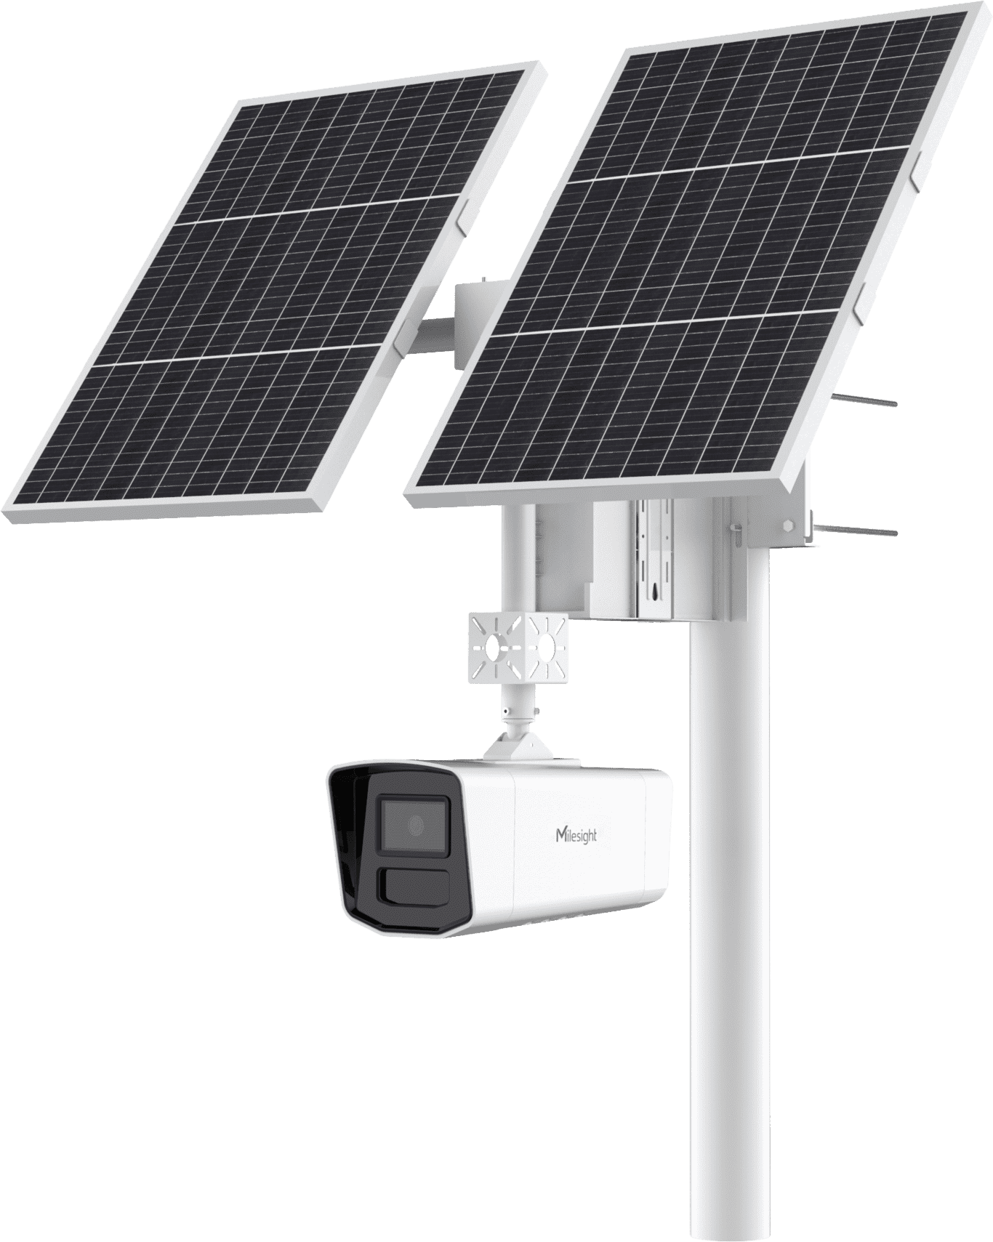
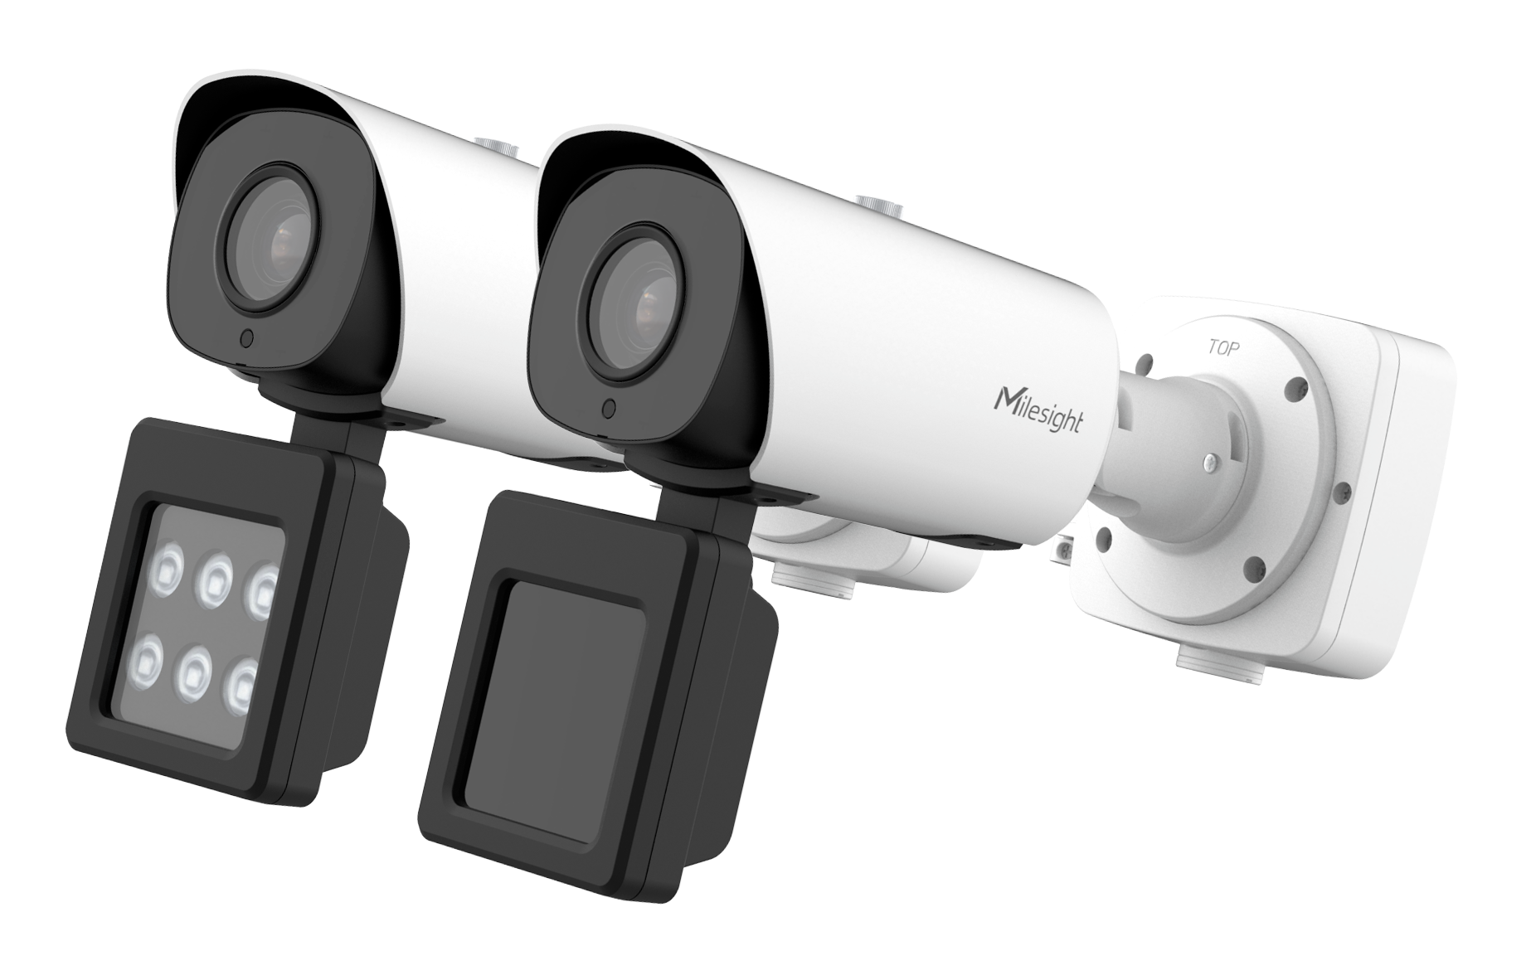
Main Series Compatibility
Functions
Liveview
Playback
2-way Audio
Media
Configuration
PTZ
Event
& Action
Models
Mini Series
/
Pro Series
/
PTZ Series
360° Fisheye
/
180° Panoramic Dome/Bullet
/
Dual- sensor
/
Multi- sensor
/
4G Solar-powered Kit
/
Intelligent Traffic
/
Make Sensing Matter

Slide 14



THANK YOU
Stay in Touch on Milesight Social Media!
www.milesight.com
Building C09, Software Park Phase III,
Xiamen 361024, Fujian, China

